Slide 1
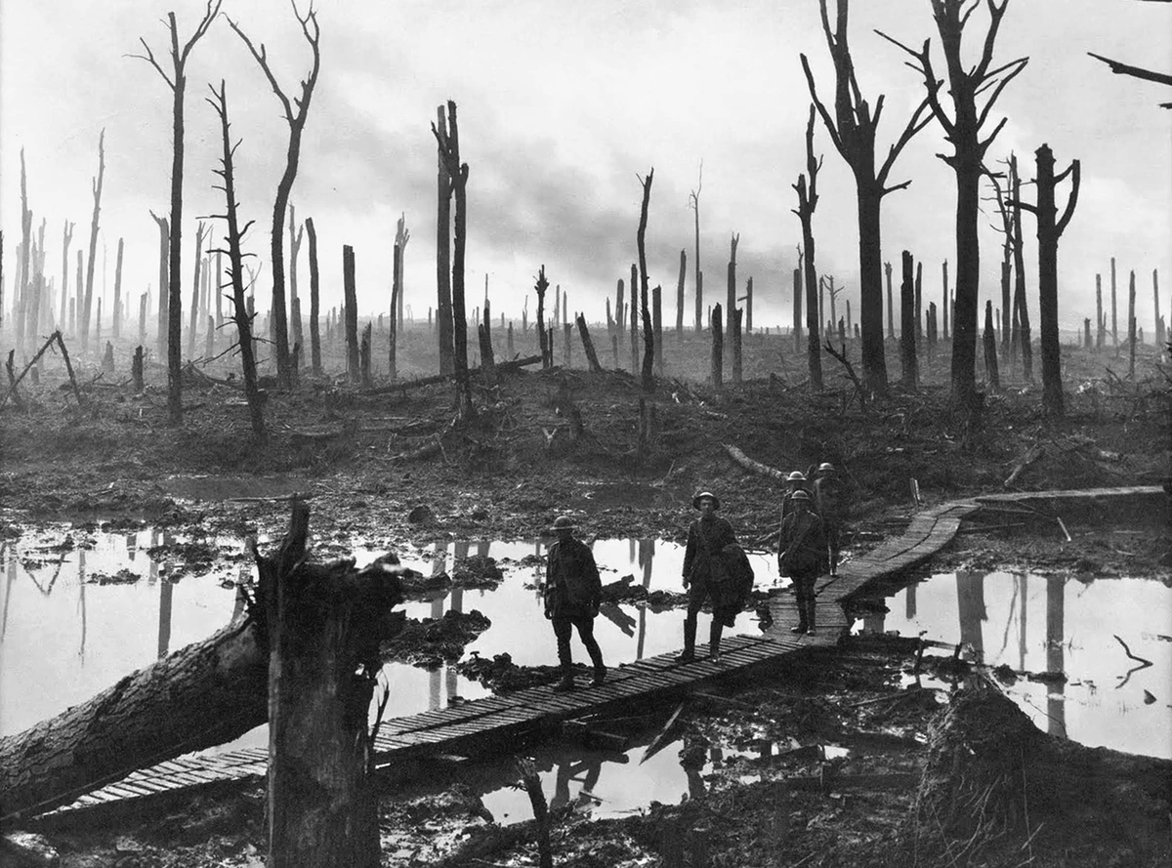
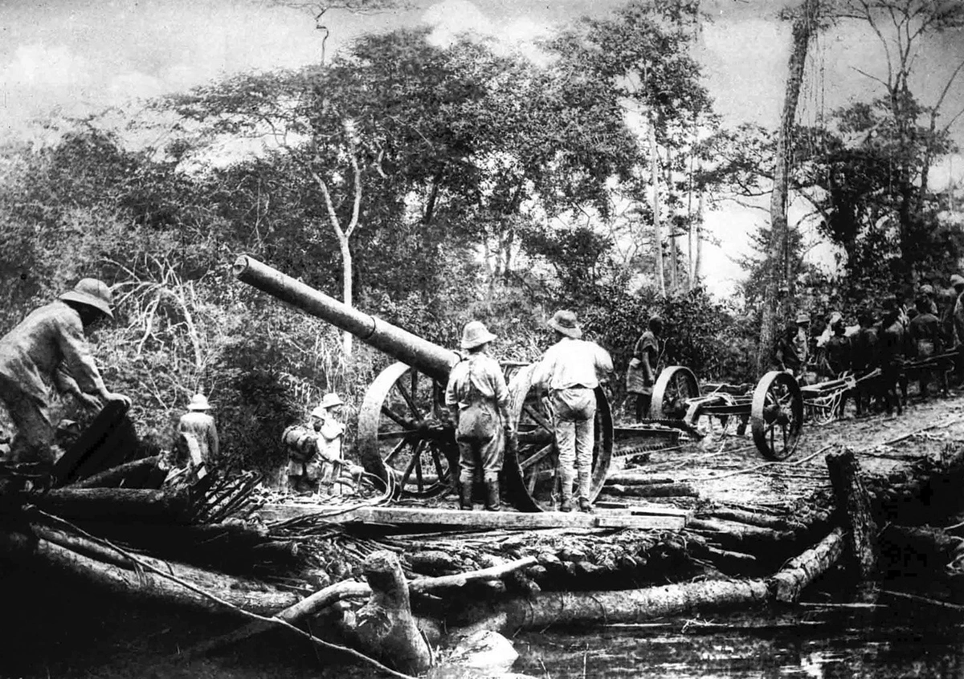
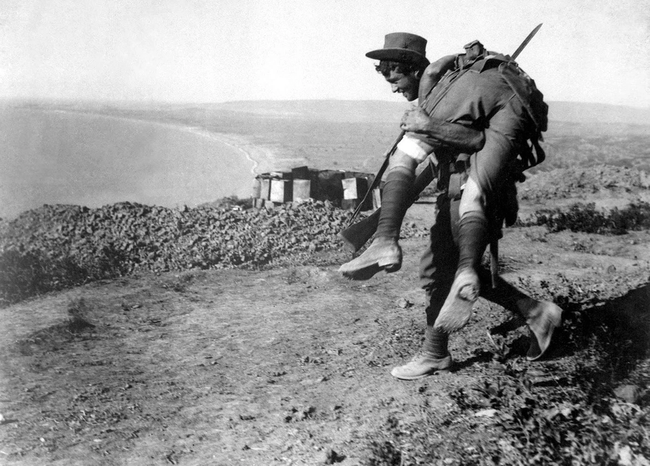
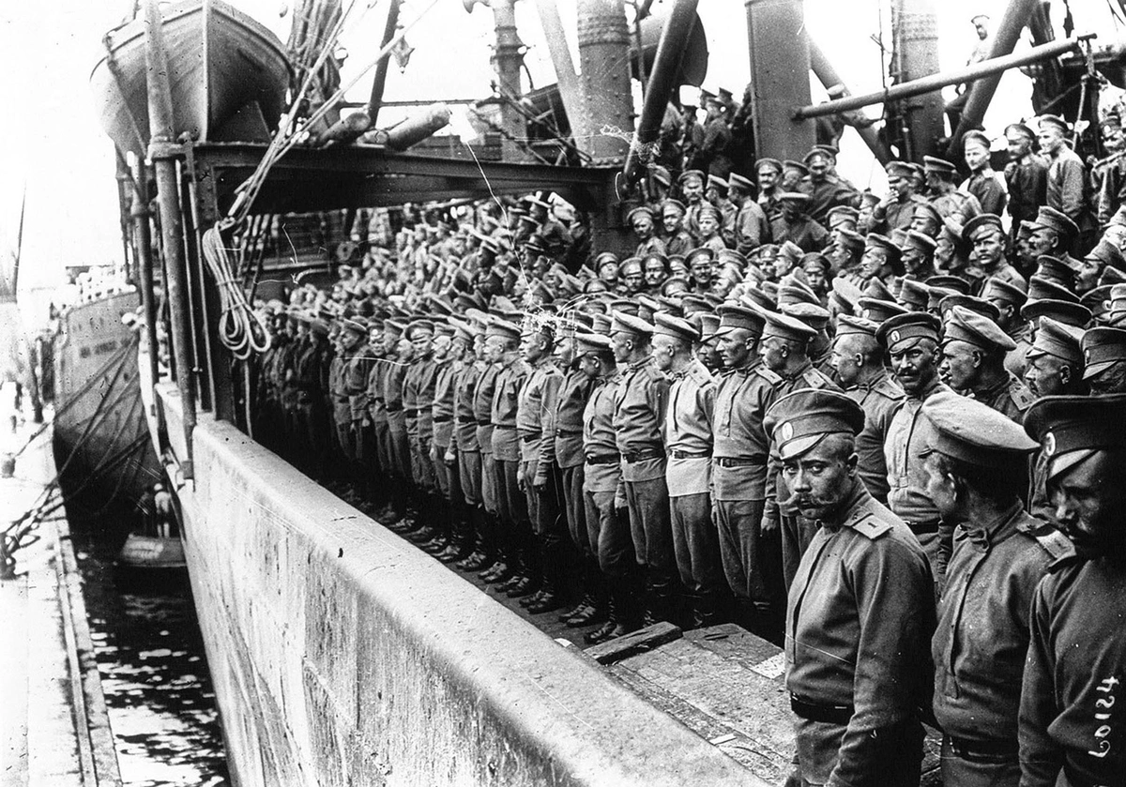
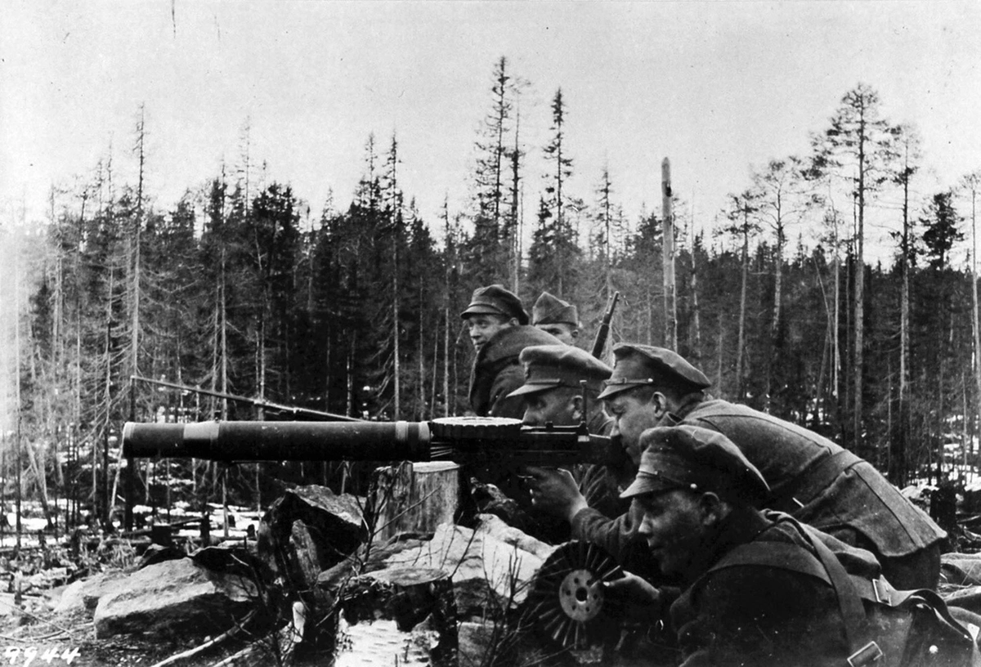
TIME OF INDIA
World War I in Photos: Global Conflict
Assembl Russia entered World War I with an army which was massive but badly armed. Russia suffered quick body blows from Germany and went on to one disaster after another. It lost 1,650,000 men killed, 3,850,000 wounded and 2,410,000 prisoners before the 1917 revolution which ousted the tsar and ended Russia's part in the war. Here reservists accompanied by relatives, are called up in St. Petersburg as the army was assembleded
Anzac, Gallipoli, October of 1915. The "Sphinx" "Cathedral". The front tents were occupied by No. 1 Clearing Hospital
"world" in World War
Guns removed from the wreck of the SMS Konigsberg. The Germans recovered Konigsberg's ten 105-millimeter (4.1 in) quick-firing guns, mounted them on improvised field carriages, carried them away, and used them with great success as powerful field guns in their guerrilla campaign against the Allies around East Africa
Russia entered World War I with an army which was massive but badly armed. Russia suffered quick body blows from Germany and went on to one disaster after another. It lost 1,650,000 men killed, 3,850,000 wounded and 2,410,000 prisoners before the 1917 revolution which ousted the tsar and ended Russia's part in the war. Here reservists, accompanied by relatives, are called up in St. Petersburg as the army was assembled
Chinese laborers at a roll-call in France, during World War I. The coastal towns of China and Hong Kong, where Britain still had some influence, were the main areas from which Chinese laborers were recruited. Over 320,000 were recruited for service with the Allied Forces despite the fact that China was engrossed in her own domestic turmoil
Chinese laborers at a roll-call in France, during World War I. The coastal towns of China and Hong Kong, where Britain still had some influence, were the main areas from which Chinese laborers were recruited. Over 320,000 were recruited for service with the Allied Forces despite the fact that China was engrossed in her own domestic turmoil
An Australian bringing in a wounded comrade to hospital. Dardanelles Campaign, ca. 1915
The Russians arrive in Marseille. France had asked Russia for help on the Western Front, and Russia responded by sending five Special Brigades -- nearly 45,000 soldiers
A low flying German Fokker E.II 35/15, somewhere on the Eastern Front, ca. 1915
Salvo-British troops with Lewis guns. These troops were native Russians in British uniforms and commanded by the British. A British officer is on the right of the gunner

Slide 2
TIME OF INDIA
World War I in Photos: Global Conflict
Assembl Russia entered World War I with an army which was massive but badly armed. Russia suffered quick body blows from Germany and went on to one disaster after another. It lost 1,650,000 men killed, 3,850,000 wounded and 2,410,000 prisoners before the 1917 revolution which ousted the tsar and ended Russia's part in the war. Here reservists accompanied by relatives, are called up in St. Petersburg as the army was assembleded
Anzac, Gallipoli, October of 1915. The "Sphinx" "Cathedral". The front tents were occupied by No. 1 Clearing Hospital
"world" in World War
Guns removed from the wreck of the SMS Konigsberg. The Germans recovered Konigsberg's ten 105-millimeter (4.1 in) quick-firing guns, mounted them on improvised field carriages, carried them away, and used them with great success as powerful field guns in their guerrilla campaign against the Allies around East Africa
Russia entered World War I with an army which was massive but badly armed. Russia suffered quick body blows from Germany and went on to one disaster after another. It lost 1,650,000 men killed, 3,850,000 wounded and 2,410,000 prisoners before the 1917 revolution which ousted the tsar and ended Russia's part in the war. Here reservists, accompanied by relatives, are called up in St. Petersburg as the army was assembled
Chinese laborers at a roll-call in France, during World War I. The coastal towns of China and Hong Kong, where Britain still had some influence, were the main areas from which Chinese laborers were recruited. Over 320,000 were recruited for service with the Allied Forces despite the fact that China was engrossed in her own domestic turmoil
Chinese laborers at a roll-call in France, during World War I. The coastal towns of China and Hong Kong, where Britain still had some influence, were the main areas from which Chinese laborers were recruited. Over 320,000 were recruited for service with the Allied Forces despite the fact that China was engrossed in her own domestic turmoil
An Australian bringing in a wounded comrade to hospital. Dardanelles Campaign, ca. 1915
The Russians arrive in Marseille. France had asked Russia for help on the Western Front, and Russia responded by sending five Special Brigades -- nearly 45,000 soldiers
A low flying German Fokker E.II 35/15, somewhere on the Eastern Front, ca. 1915
Salvo-British troops with Lewis guns. These troops were native Russians in British uniforms and commanded by the British. A British officer is on the right of the gunner

Slide 3
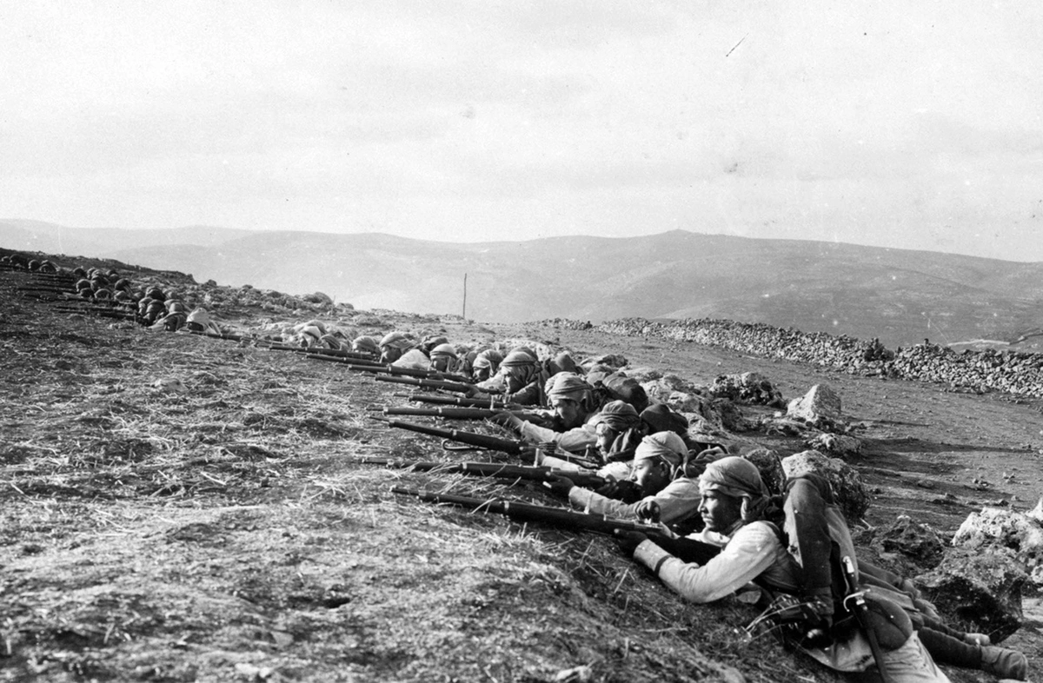
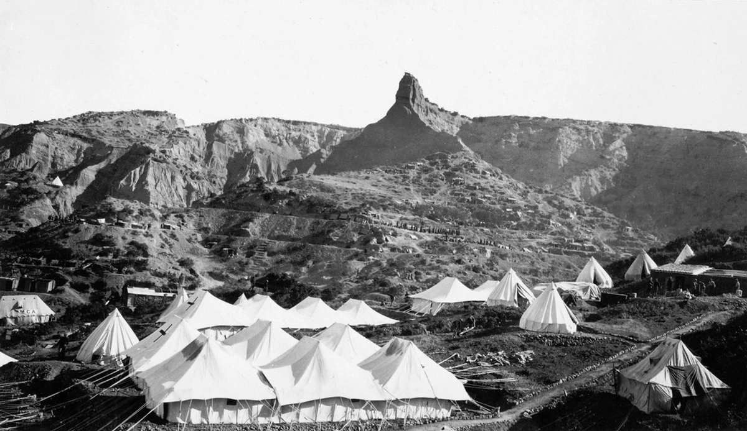
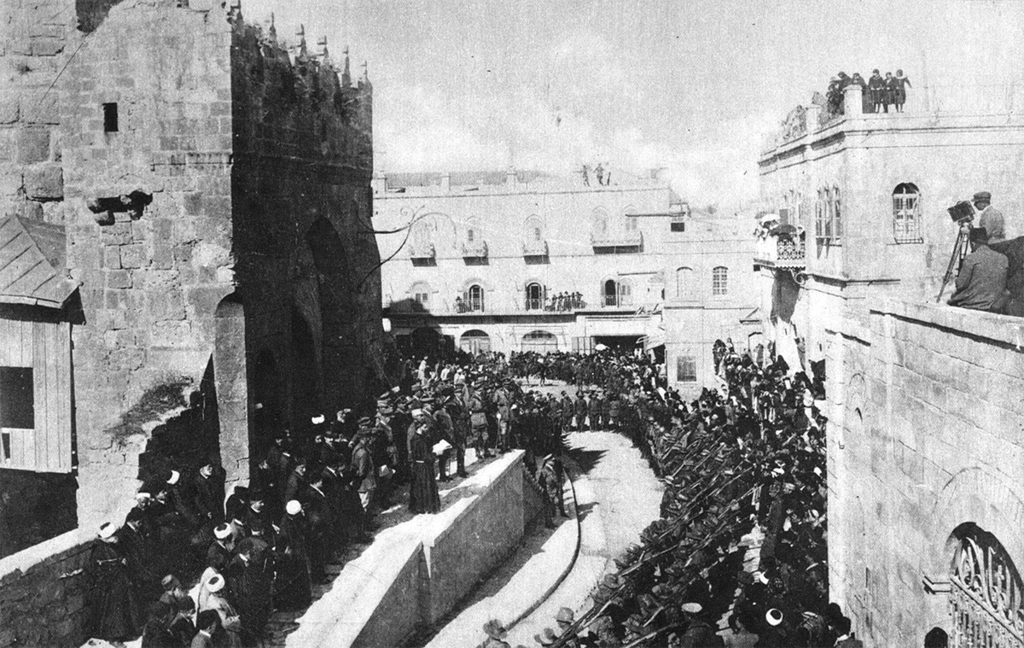
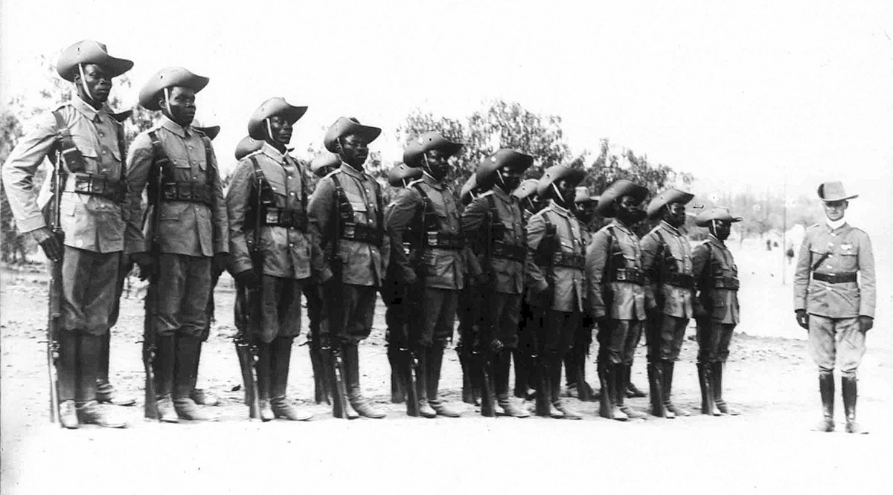
TIME OF INDIA
World War I in Photos: Global Conflict
Assembl Russia entered World War I with an army which was massive but badly armed. Russia suffered quick body blows from Germany and went on to one disaster after another. It lost 1,650,000 men killed, 3,850,000 wounded and 2,410,000 prisoners before the 1917 revolution which ousted the tsar and ended Russia's part in the war. Here reservists accompanied by relatives, are called up in St. Petersburg as the army was assembleded
Anzac, Gallipoli, October of 1915. The "Sphinx" "Cathedral". The front tents were occupied by No. 1 Clearing Hospital
"world" in World War
Guns removed from the wreck of the SMS Konigsberg. The Germans recovered Konigsberg's ten 105-millimeter (4.1 in) quick-firing guns, mounted them on improvised field carriages, carried them away, and used them with great success as powerful field guns in their guerrilla campaign against the Allies around East Africa
Russia entered World War I with an army which was massive but badly armed. Russia suffered quick body blows from Germany and went on to one disaster after another. It lost 1,650,000 men killed, 3,850,000 wounded and 2,410,000 prisoners before the 1917 revolution which ousted the tsar and ended Russia's part in the war. Here reservists, accompanied by relatives, are called up in St. Petersburg as the army was assembled
Chinese laborers at a roll-call in France, during World War I. The coastal towns of China and Hong Kong, where Britain still had some influence, were the main areas from which Chinese laborers were recruited. Over 320,000 were recruited for service with the Allied Forces despite the fact that China was engrossed in her own domestic turmoil
Chinese laborers at a roll-call in France, during World War I. The coastal towns of China and Hong Kong, where Britain still had some influence, were the main areas from which Chinese laborers were recruited.
An Australian bringing in a wounded comrade to hospital. Dardanelles Campaign, ca. 1915
The reading of a proclamation at the Tower of David in Jerusalem, December 11, 1917 -- two days after the Ottoman Army had surrendered and handed the city over to Allied troops. See this same location today on google maps street view
Infantry lines North of Jerusalem, near Nebi Samuel, 1917. The Battle of Jerusalem ended up with British forces taking control of Jerusalem from the Ottoman Empire
Anzac, Gallipoli, October of 1915. The "Sphinx" or "Cathedral". The front tents were occupied by No. 1 Clearing Hospital.

Slide 4
TIME OF INDIA
World War I in Photos: Global Conflict
Assembl Russia entered World War I with an army which was massive but badly armed. Russia suffered quick body blows from Germany and went on to one disaster after another. It lost 1,650,000 men killed, 3,850,000 wounded and 2,410,000 prisoners before the 1917 revolution which ousted the tsar and ended Russia's part in the war. Here reservists accompanied by relatives, are called up in St. Petersburg as the army was assembleded
Anzac, Gallipoli, October of 1915. The "Sphinx" "Cathedral". The front tents were occupied by No. 1 Clearing Hospital
"world" in World War
Guns removed from the wreck of the SMS Konigsberg. The Germans recovered Konigsberg's ten 105-millimeter (4.1 in) quick-firing guns, mounted them on improvised field carriages, carried them away, and used them with great success as powerful field guns in their guerrilla campaign against the Allies around East Africa
Russia entered World War I with an army which was massive but badly armed. Russia suffered quick body blows from Germany and went on to one disaster after another. It lost 1,650,000 men killed, 3,850,000 wounded and 2,410,000 prisoners before the 1917 revolution which ousted the tsar and ended Russia's part in the war. Here reservists, accompanied by relatives, are called up in St. Petersburg as the army was assembled
Chinese laborers at a roll-call in France, during World War I. The coastal towns of China and Hong Kong, where Britain still had some influence, were the main areas from which Chinese laborers were recruited. Over 320,000 were recruited for service with the Allied Forces despite the fact that China was engrossed in her own domestic turmoil
Chinese laborers at a roll-call in France, during World War I. The coastal towns of China and Hong Kong, where Britain still had some influence, were the main areas from which Chinese laborers were recruited.
An Australian bringing in a wounded comrade to hospital. Dardanelles Campaign, ca. 1915
The reading of a proclamation at the Tower of David in Jerusalem, December 11, 1917 -- two days after the Ottoman Army had surrendered and handed the city over to Allied troops. See this same location today on google maps street view
Infantry lines North of Jerusalem, near Nebi Samuel, 1917. The Battle of Jerusalem ended up with British forces taking control of Jerusalem from the Ottoman Empire
Anzac, Gallipoli, October of 1915. The "Sphinx" or "Cathedral". The front tents were occupied by No. 1 Clearing Hospital.

